Slide 1
Review for GR
Sequences (11.1)
Series (11.2-11.11 & 10.1)
Converge/Diverge and sum
Be able to use all of the tools in your toolbox
Taylor & Maclaurin
Parametric Equations

Slide 2
Math 152
Lesson | Topic | Reading
32 | Applications of Taylor Polynomials | 11.11
33 | Parametric Equations | 10.1
34 | GR #3
Objectives:
TBD

Slide 3
Curves Defined by Parametric Equations
Imagine that a particle moves along the curve C shown in Figure 1. It is impossible to describe C by an equation of the form y = f (x) because C fails the Vertical Line Test.
Figure 1

Slide 4
Curves Defined by Parametric Equations
Each value of t determines a point (x, y), which we can plot in a coordinate plane.
As t varies, the point (x, y) = (f (t), g (t)) varies and traces out a curve C, which we call a parametric curve.
The parameter t does not necessarily represent time and, in fact, we could use a letter other than t for the parameter.

Slide 5
Example
Sketch and identify the curve defined by the parametric equations
x = t² – 2t y = t + 1
Solution: Each value of t gives a point on the curve, as shown in the table.

Slide 6
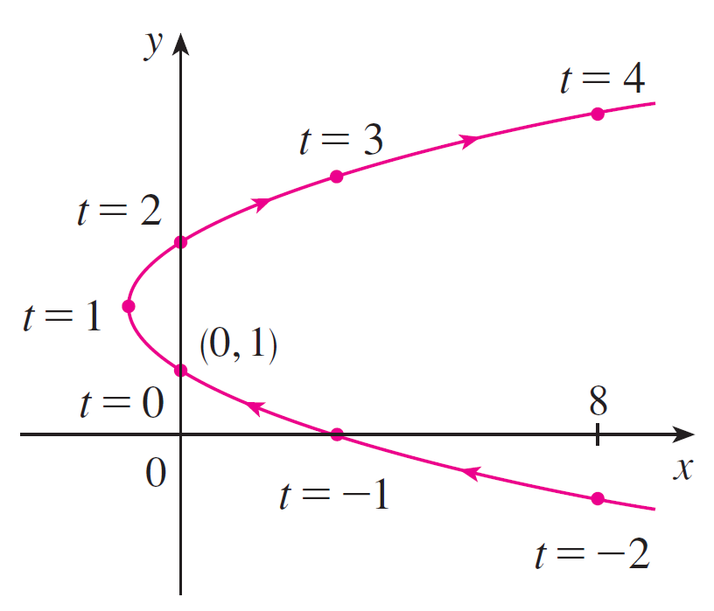
Example
For instance, if t = 0, then x = 0, y = 1, and so the corresponding point is (0, 1).
In Figure 2 we plot the points (x, y) determined by several values of the parameter and we join them to produce a curve.
Figure 2

Slide 7
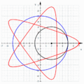
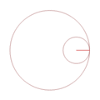
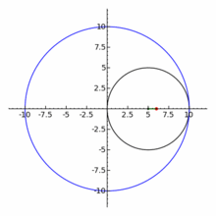
Hypotrochoid
A hypotrochoid is a roulette traced by a point attached to a circle of radius r rolling around the inside of a fixed circle of radius R, where the point is a distance d from the center of the interior circle.
R=5, r=3, d=5
r=d
R = 10, r = 5, d = 1

Slide 8
Launch Trajectory
Altitude: h(T) = 2008 - 0.047 T³ + 18.3 T² - 345T
Down Range Distance: R(T) = 4680 e^{0.029T}
Speed = ( (dh/dT)² + (dR/dT)² )^{1/2}
( (- 0.142 T² + 36.6 T - 345 )² + (135.7 e ^{0.029T} )² )^{1/2}
h(T)
dR/dT = 135.7 e ^{0.029T}
dh/dT = - 0.142 T² + 36.6 T - 345
S(T)
h(T)
R(T)
R(T)

Slide 9
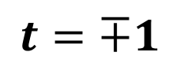
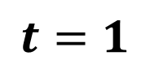
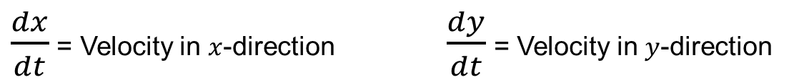
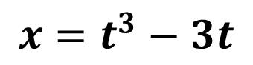
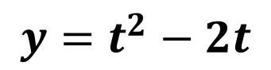
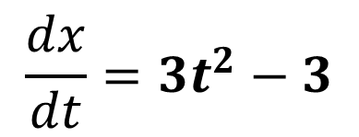
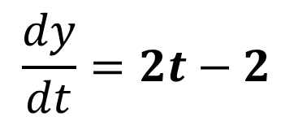
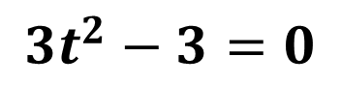
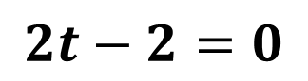
Speed
For $x$ and $y$ in meters, a particle moves according to the parametric equation:
$$x=t^{3}−3t$$
$$y=t^{2}−2t$$
Does the particle ever stop?
Is the particle ever moving straight left or right horizontally (x)?
Is the particle ever moving straight up or down vertically (y)?
$\frac{dx}{dt}$ = Velocity in $x$-direction $\frac{dy}{dt}$ = Velocity in $y$-direction
$$\frac{dx}{dt}={3t}^{2}−3$$
$$\frac{dy}{dt}=2t−2$$
$${3t}^{2}−3=0$$
$$2t−2=0$$
$$t=∓1$$
$$t=1$$
Notes:
yes, if dx/dt = 0 AND dy/dt = 0 at the same time…t = +1
Dy/dt = 0 only…no, because the only place dy/dt = 0, dx/dt = 0…no motion
horizontal movement, but no vertical: no H @ t = -1 or 1; no V @ t = 1. So, at t = -1

Slide 10
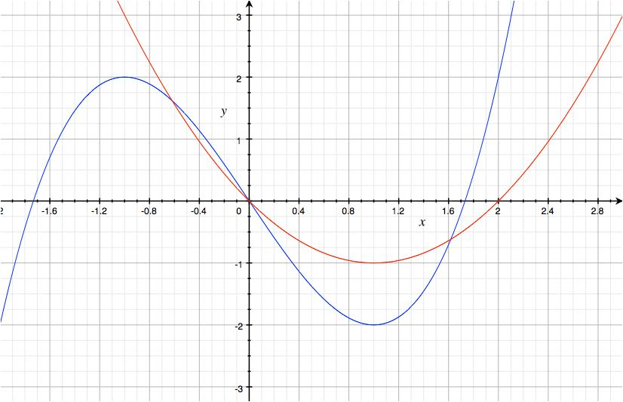
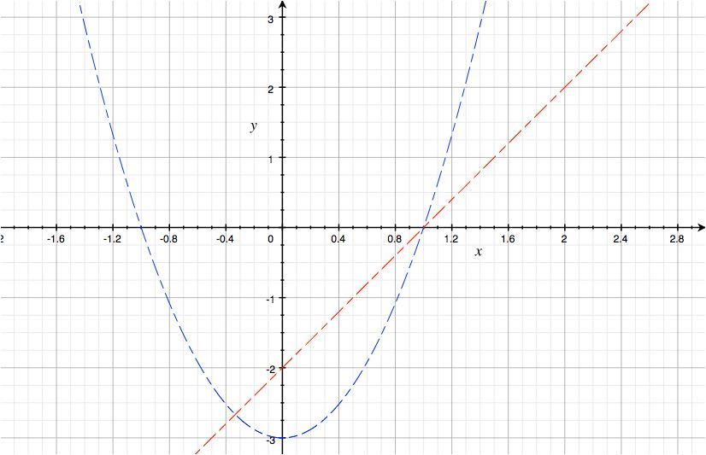
Example
Position
Velocity
Stop @ t=1
Only x stop @ t=-1
Only y is moving @ t=-1
X=blue y = red

Slide 11
Backups

Slide 12
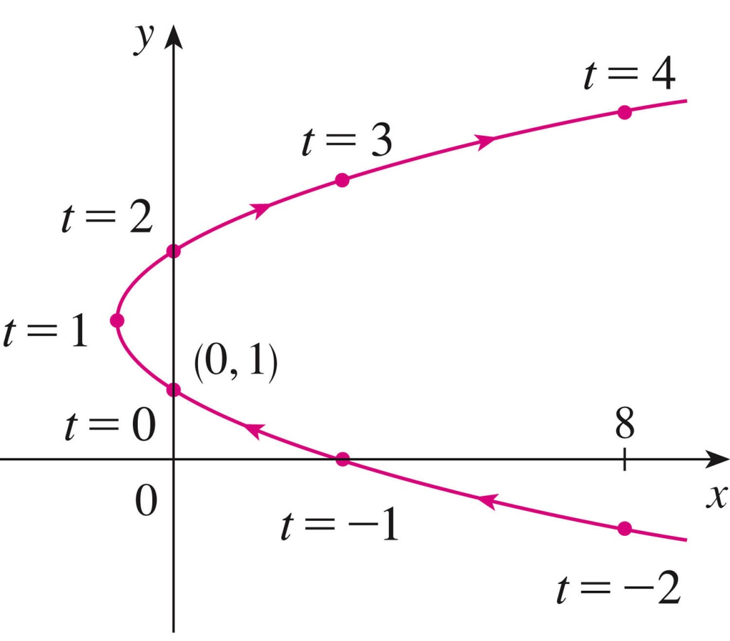
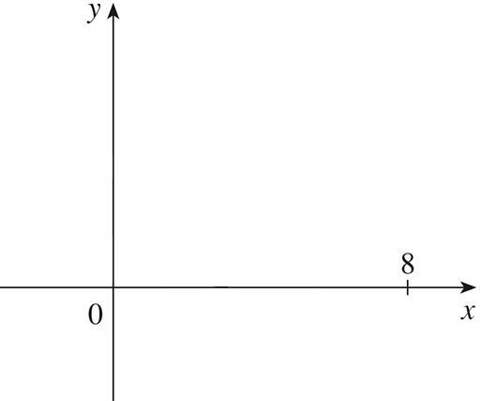
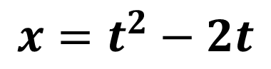
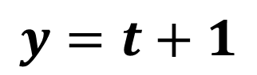
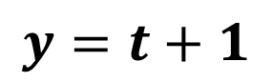
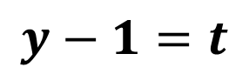
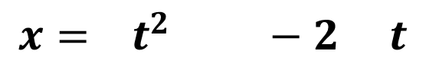
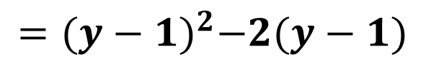
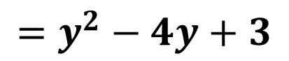
Cartesian From Parametric
$$x=t^{2}−2t$$
$$y=t+1$$
$$y=t+1$$
$$y−1=t$$
$$x= t^{2} −2 t$$
$$={(y−1)}^{2}−2(y−1)$$
$$=y^{2}−4y+3$$

Slide 13
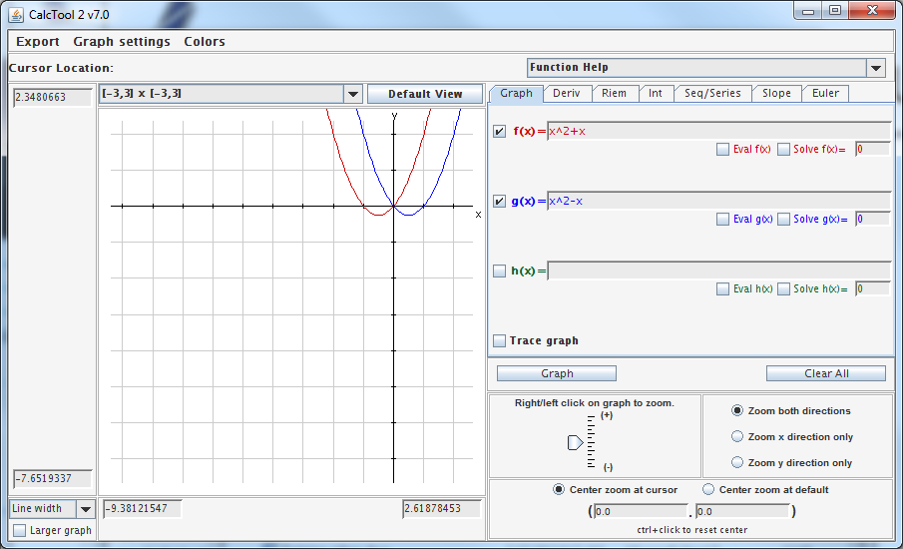
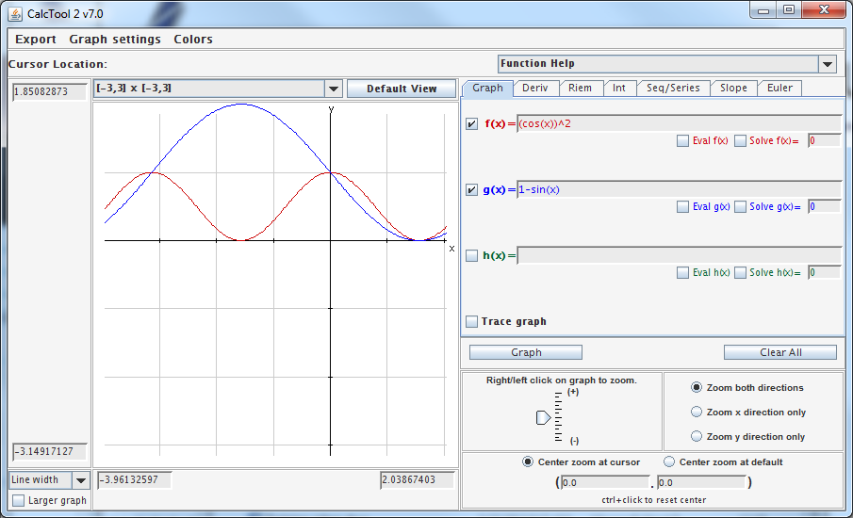
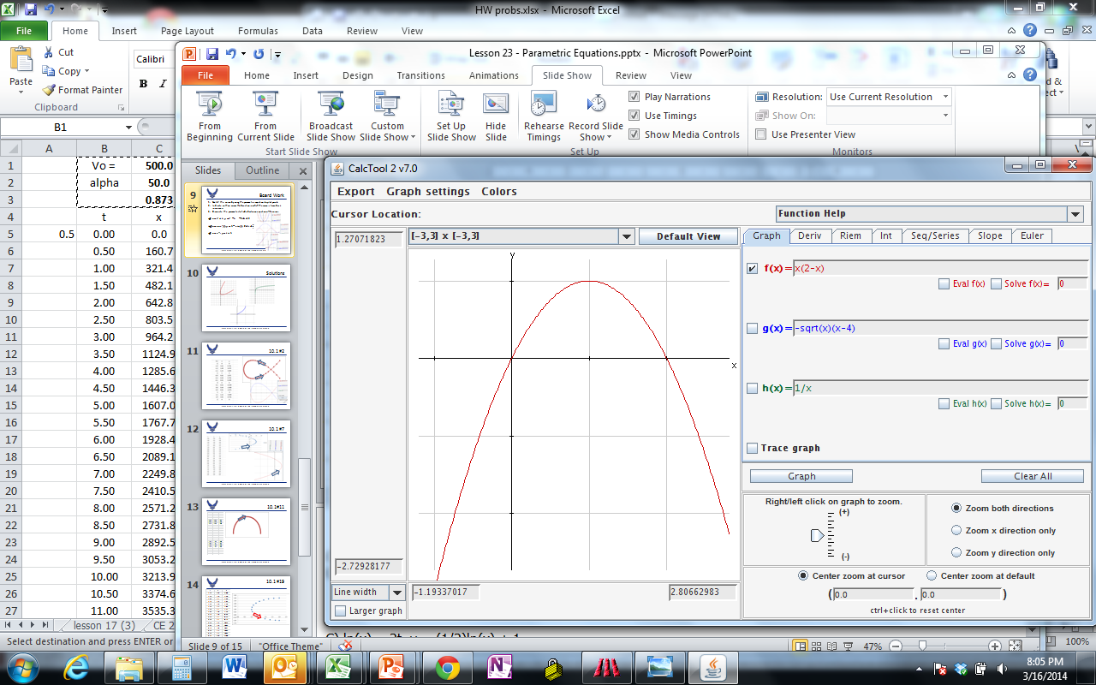
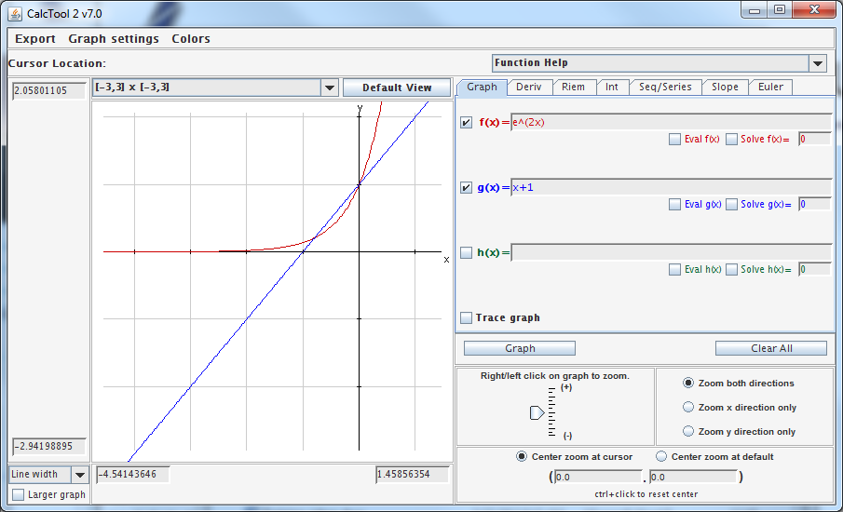
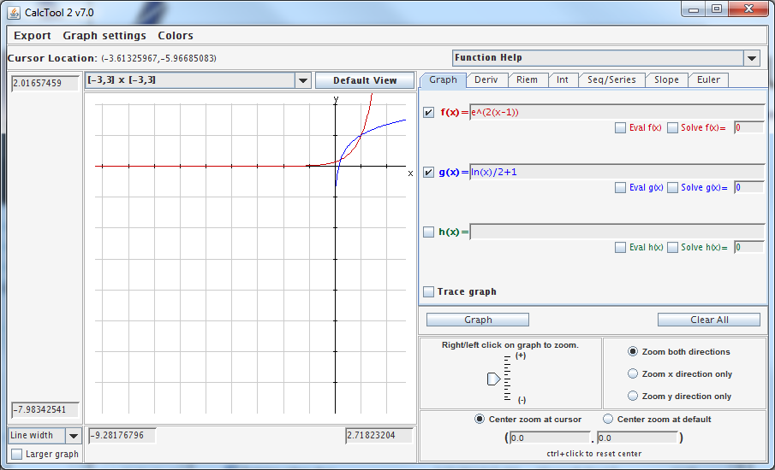
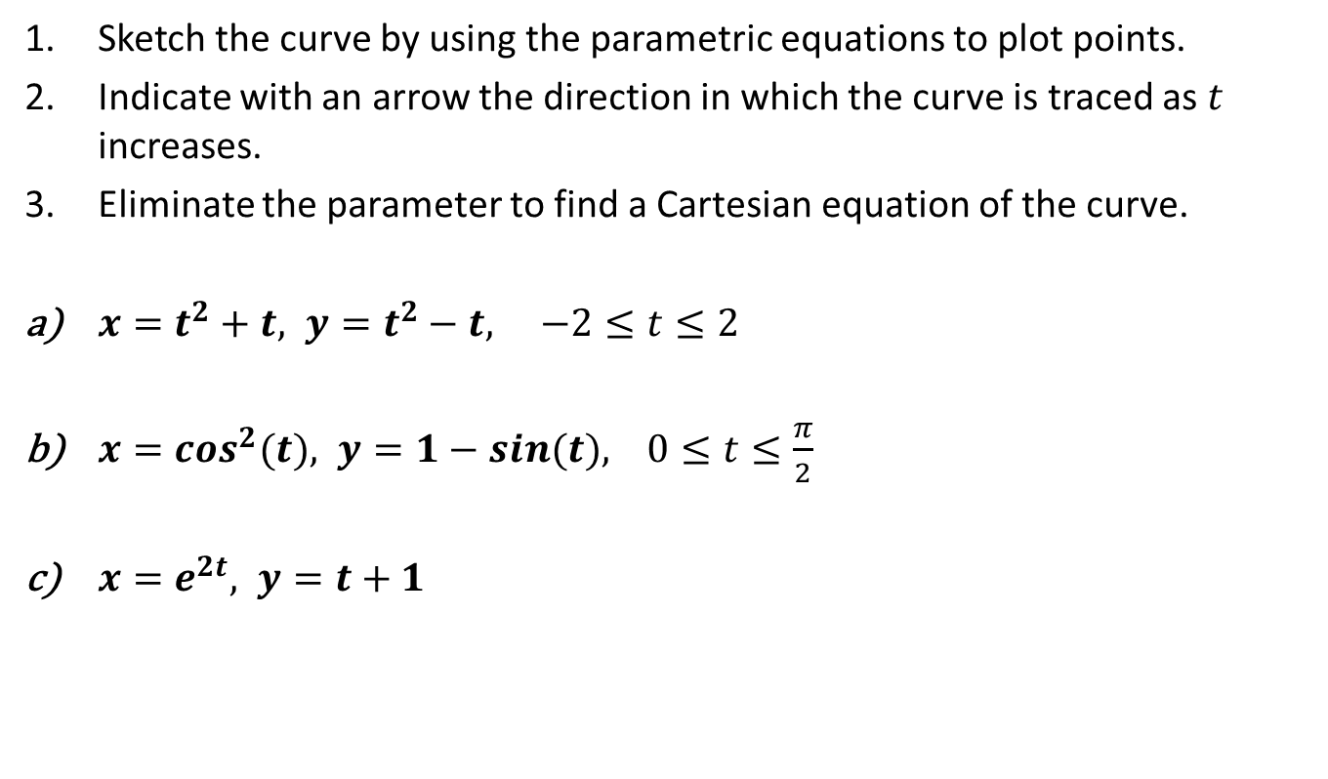
Board Work
Sketch the curve by using the parametric equations to plot points.
Indicate with an arrow the direction in which the curve is traced as $t$ increases.
Eliminate the parameter to find a Cartesian equation of the curve.
$x=t^{2}+t, y=t^{2}−t, −2≤t≤2$
$x=\cos^{2}(t), y=1−sin⁡(t), 0≤t≤\frac{π}{2}$
$x=e^{2t}, y=t+1$
Notes:
a) t^2 = x – t, y = t^2 – t = (x – t) – t = x -2t,
t^2+t-x = 0 = t^2 – t - y…solve for “t” in terms of “x & y” … “y = x – 2t”
b) X = cos^2, y = 1 – sin
sin = 1 – y
sin^2 = (1-y)^2 = 1 -2y +y^2
sin^2 – 1 = y^2 – 2y
Cos^2 + sin^2 = 1
Cos^2 + sin^2 – 1 = 0
(x) + (y^2 – 2y) = 0
x = y(2-y)
C) ln(x) = 2t, y = (1/2)ln(x) + 1
t = y – 1, x = e^(2(y-1))

Slide 14
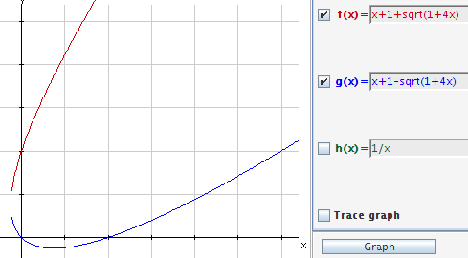
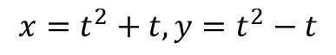
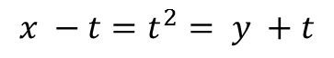
$$x=t^{2}+t, y=t^{2}−t$$
$$x −t=t^{2}= y +t$$
x – 2t = y
Notes:
t^2 = x – t, y = t^2 – t = (x – t) – t = x -2t,
t^2+t-x = 0…solve using quadratic, solve for “t” in terms of “x”, substitute into “y = x – 2t”

Slide 15
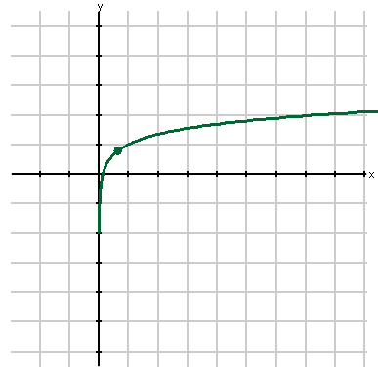
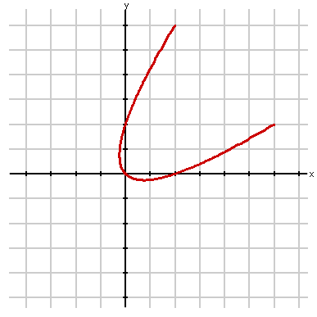
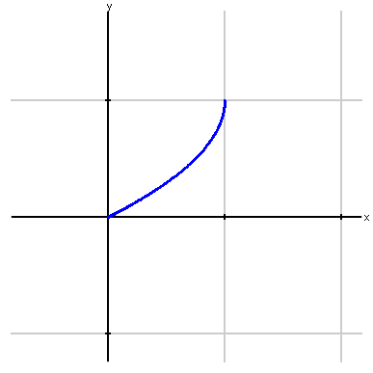
Solutions

Slide 16
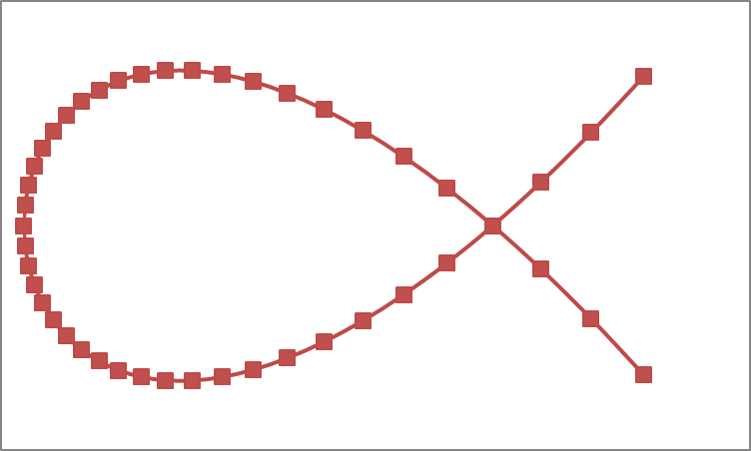
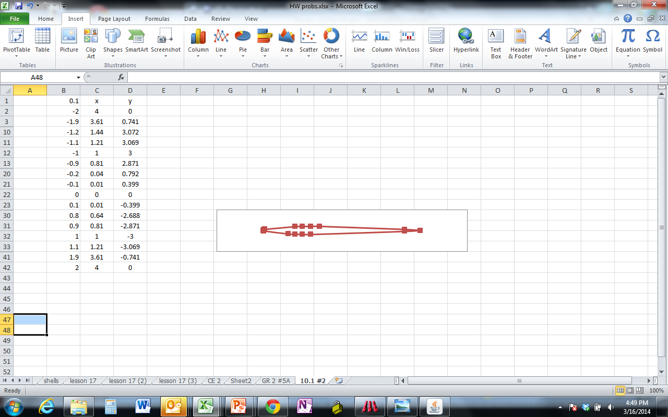
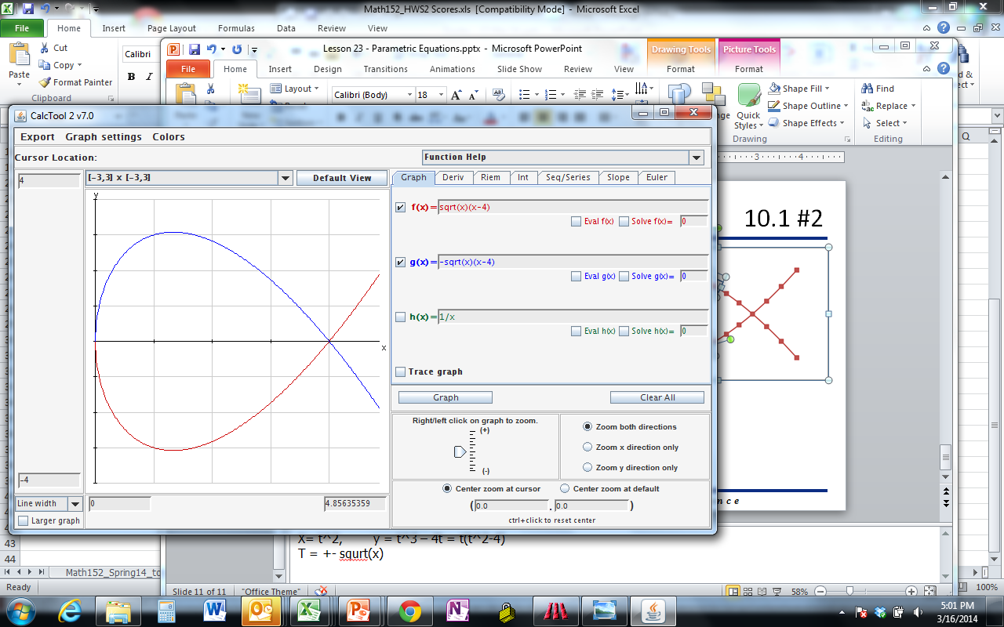
10.1 #2
Notes:
t= (-2) to (+2) is where the lines cross
x = t^2, y = t^3 – 4t = t(t^2-4)
t = +- sqrt(x)

Slide 17
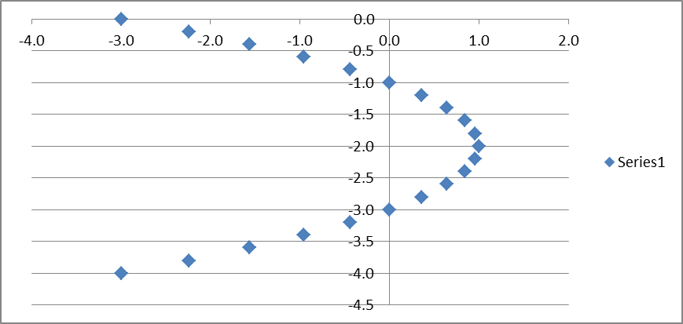
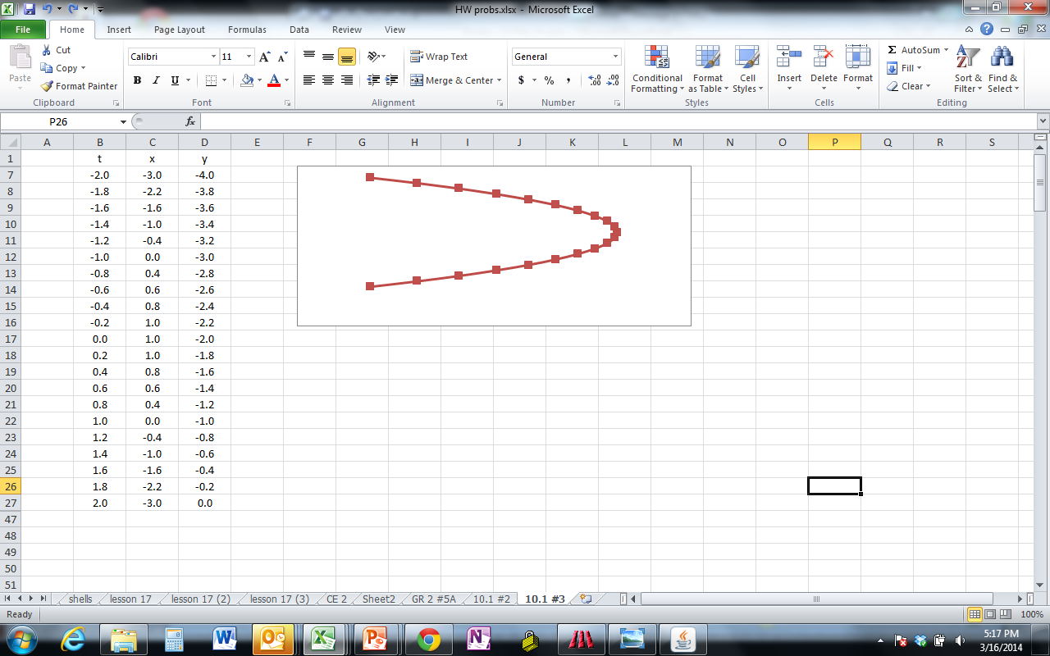
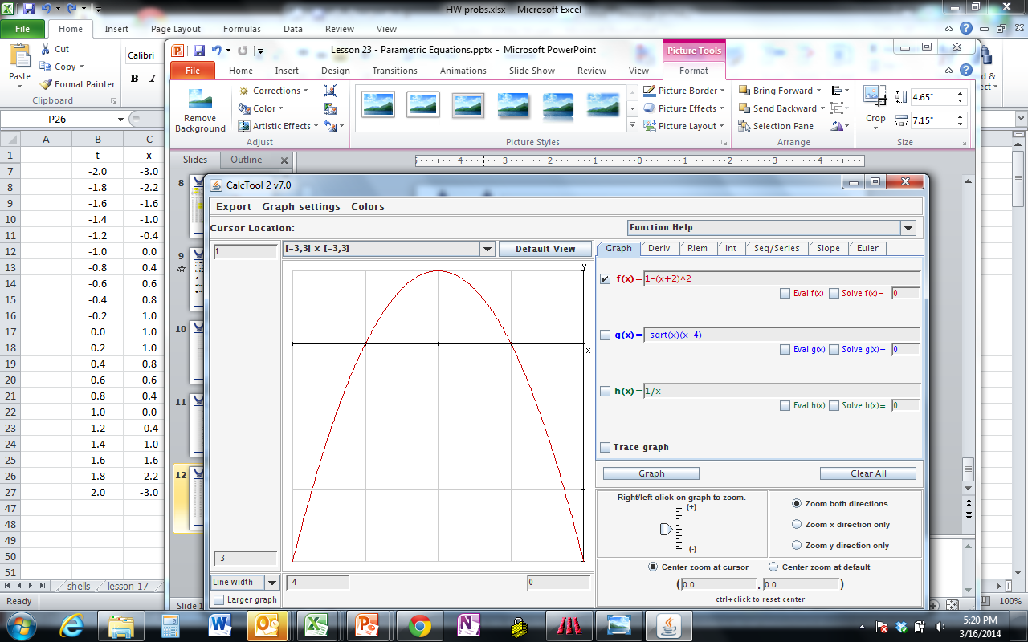
10.1 #7

Slide 18
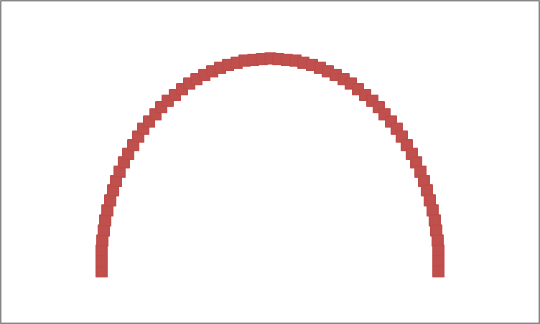
10.1#11

Slide 19
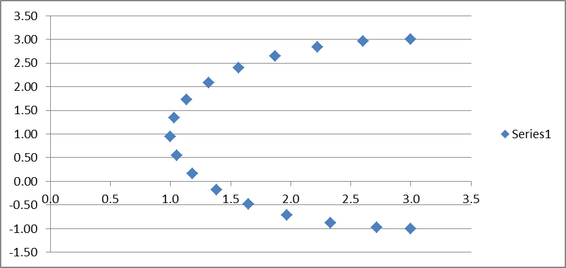
10.1 #19
Notes:
(x-3)^2 + (y-1)^2 = 4
x ε [ 1, 3] y ε [ 1, 3]

Slide 20
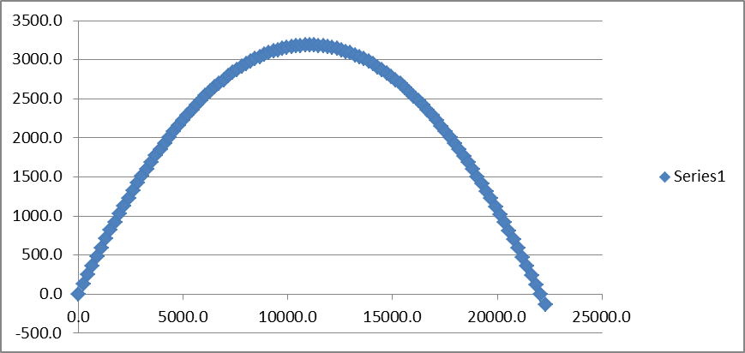
10.1 #46a
Notes:
dy/dt = 0 = Vo(sin(α) – gt t = Vo(sin(α)/g = 25.5sec
Y = 0 = Vo(sin(α)t – (g/2)t^2

